Slide 1
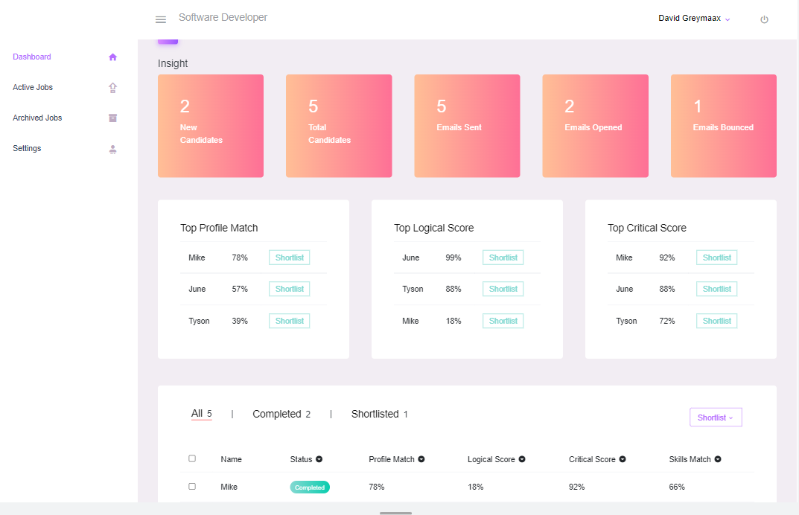
9 Yard Innovation

Slide 2
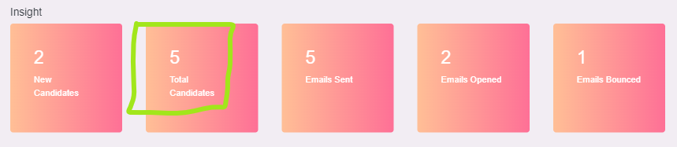
In this section, I only get the data from data dummy, except Total Candidates where I get from length of the real candidate from table.

Slide 3
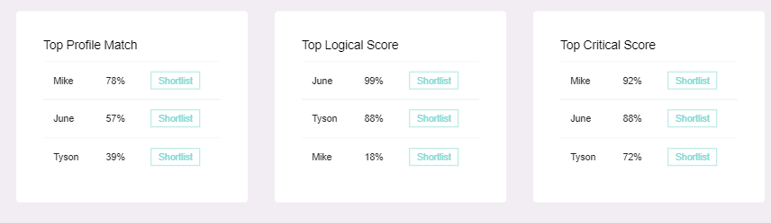
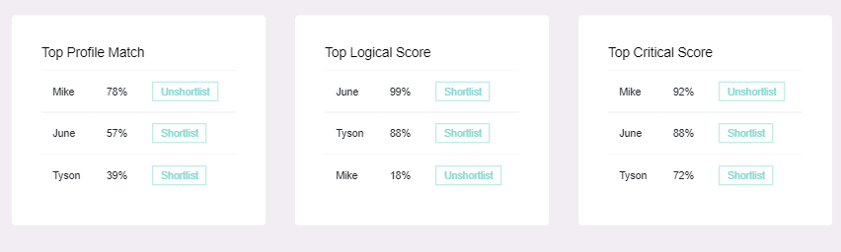
If I click ‘Shortlist’ on one of the candidate, so the candidate shorlisted. If admin want unshortlist he can click ‘Unshortlist’
→

Slide 4
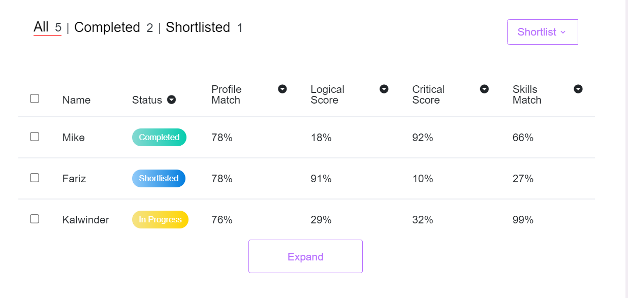
Admin can check all candidate here in tab All and click ‘expand’. If Admin want check candidates who already completed their profile, admin can check on Completed tab. So for shortlist.

